Slide 1
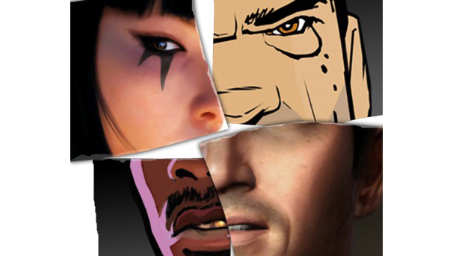
Video Games and Ethnicity

Slide 2
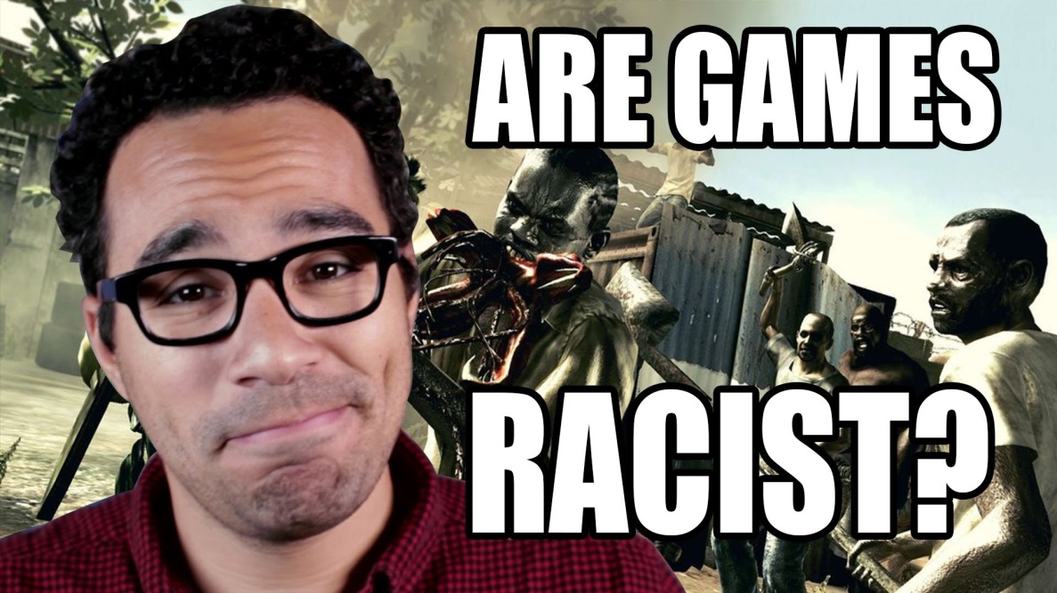
I don’t normally like to begin with a video, and yet this six minute clip (2 minutes at the end is unapplicable) does a fairly awesome job of outlining the problem and giving relevant examples.
Please watch!
Are Games Racist? | Game/Show | PBS Digital Studios - YouTube

Slide 3
White Privilege?
Not about all whites “having it easy since birth”
About certain advantages whites take for granted—often unconsciously.
This article does an EXCELLENT job of explaining the issue concisely: http://ted.coe.wayne.edu/ele3600/mcintosh.html

Slide 4
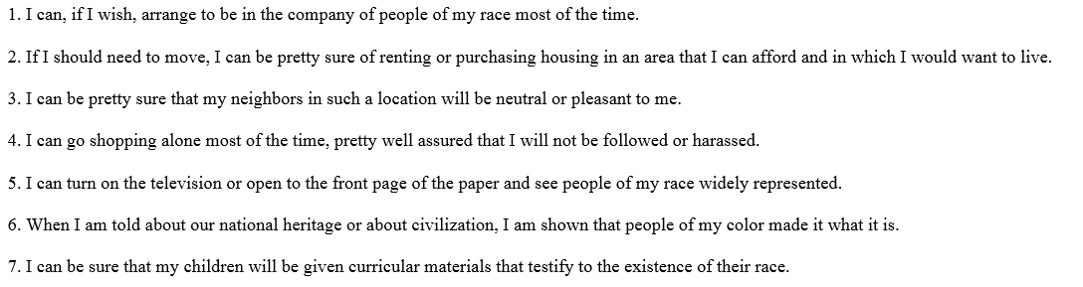
If you are white, you could very easily add the phrase “when I play a video game, I’m fairly certain my race will be represented and often in a lead or important role” to this list.
Watch this 4 min extra credits video about race and character customization: it’s fabulous!
RUST: Race in Games

Slide 5
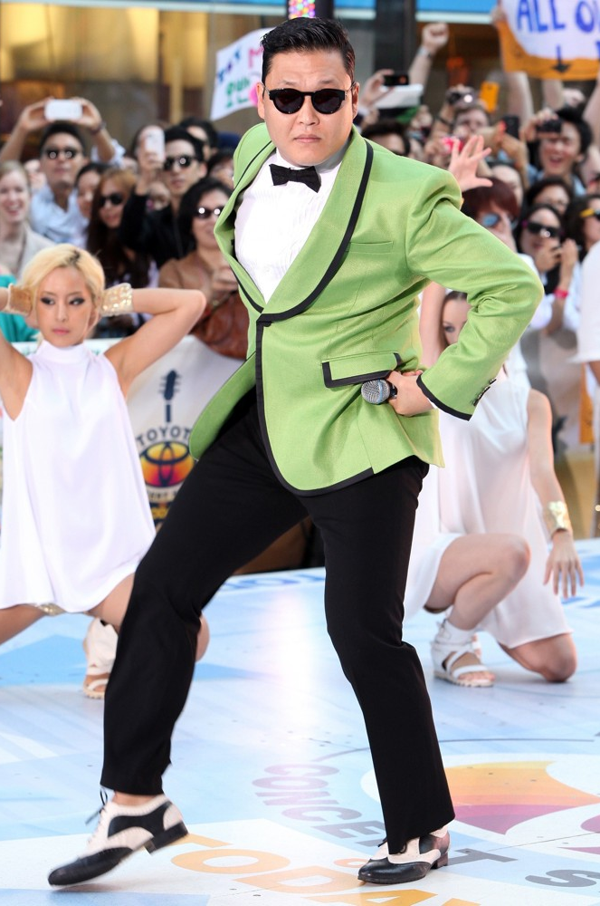
Role Models
It sounds a little “think of the children!”-ish….but seriously, if you’re Black, Native, Arab, South Asian, Latin or Asian…who are your role models in video games?
Who do you look to in the media and say “that’s me—I identify with this person!”

Slide 6
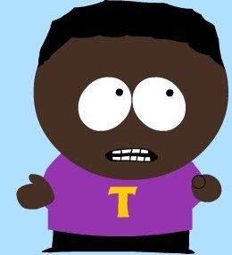
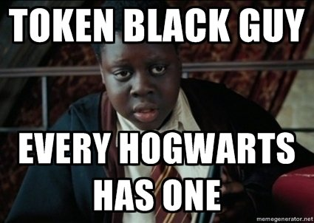
Representation: Two Parts
Visibility: How often do racial minorities appear in video games (or the media in general).
Character: When they do appear, how are these minorities portrayed? As complex “normal” characters with agency or simply stereotypes

Slide 7
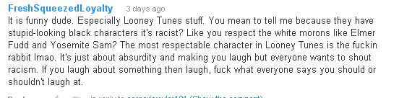
Before I Begin
This person is missing the point entirely: the conversation isn’t about “stupid cartoon characters”; the issue is much larger—there’s a history of racism and oppression in media images. African Ameicans have CONSISTENLY and REPEATEDLY been represented in VERY FEW roles (unlike caucasians).

Slide 8
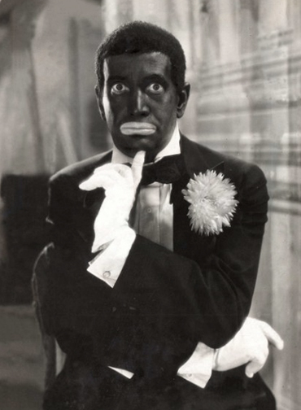
African-Americans
Film and television act as precursors for the problematic imagery and representation in video games
Originally “represented” in films by white actors in “blackface.”
Three stages:
The “Uncle Tom”
Blaxploitation
“Hood” films
Now?
Al Jolson: famous blackface actor; introduced black “culture” to a white audience. Later fought for black rights

Slide 9
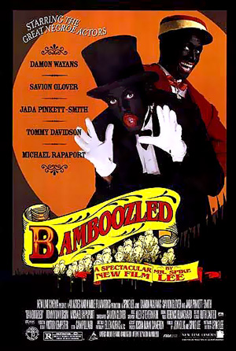
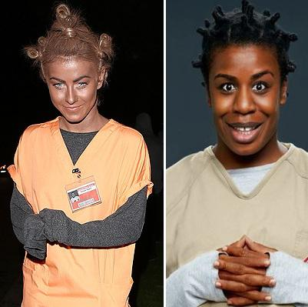
“Blackface”
Theatrical makeup used in minstrel shows, and later vaudeville, in which WHITE performers (and blacks) create a stereotyped caricature of an African American.
“Ended” in 1964
Julianne Hough’s 2013 Halloween Costume: a tribute to her favourite character on OITNB

Slide 10
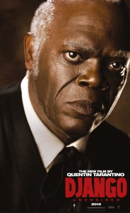
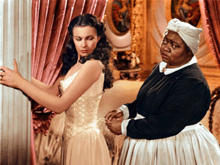
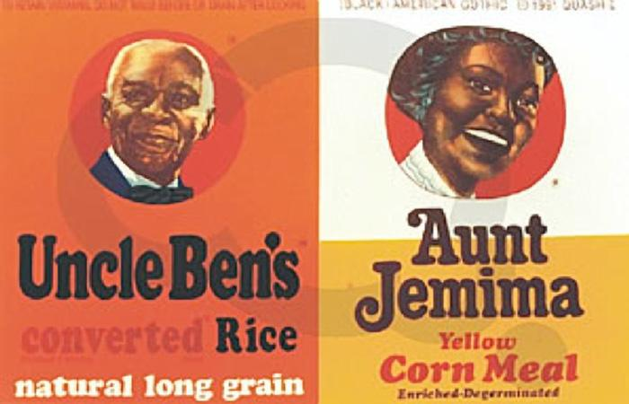
“Uncle Tom” character
Obedient
Smiling
Inoffensive
“ah shucks; I’m sorry, ya sir, right away sir”
1930s-1970s

Slide 11
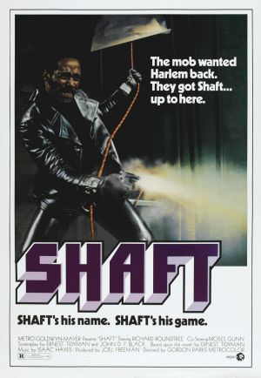

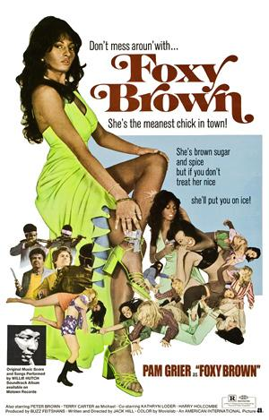
Blaxploitation
1970s
Originally made to appeal to just an AA audience
Gained wider popularity
Shows African Americans as tough and in control

Slide 12
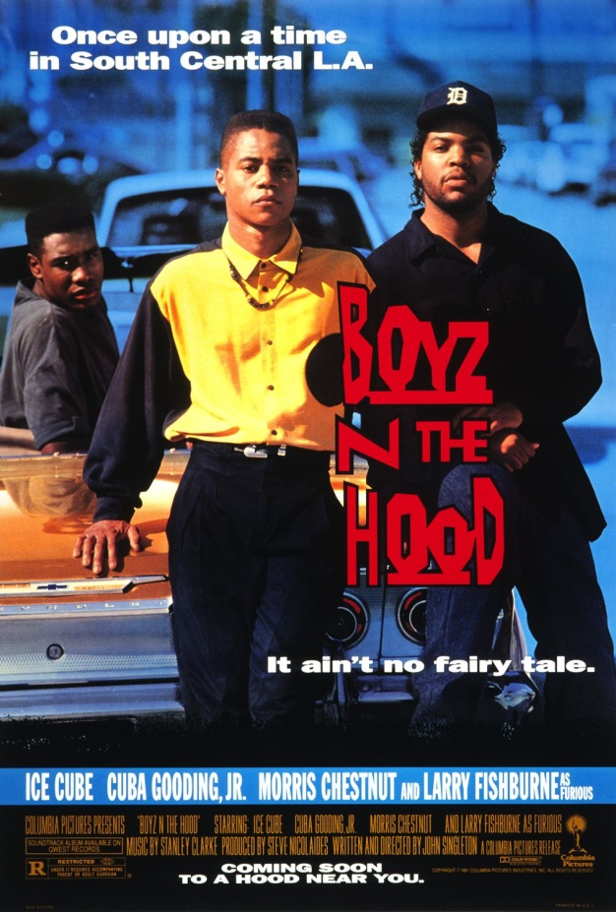
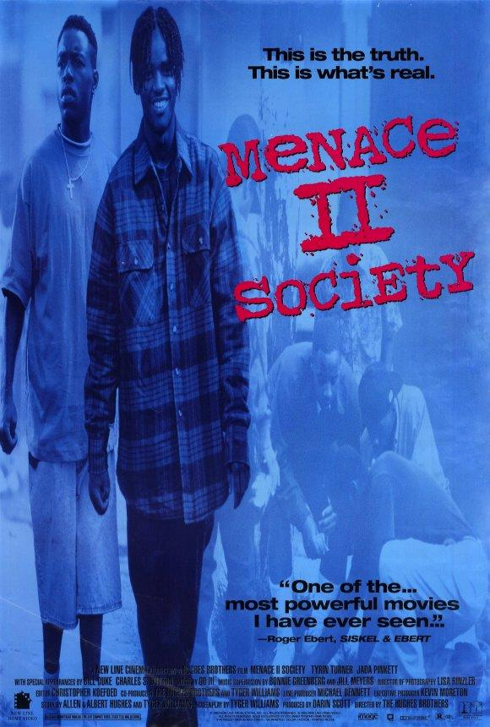
The “Hood”
1990s—coincided with the rise of gangster rap.
Portrayed urban environments as violent crime filled places inhabited by violent black criminals.
Criticized for its glorification of drugs and violence.

Slide 13
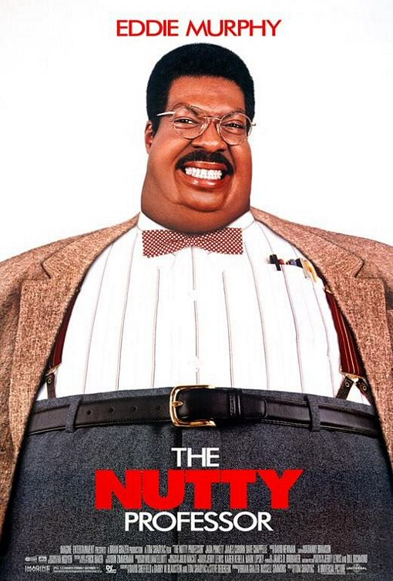
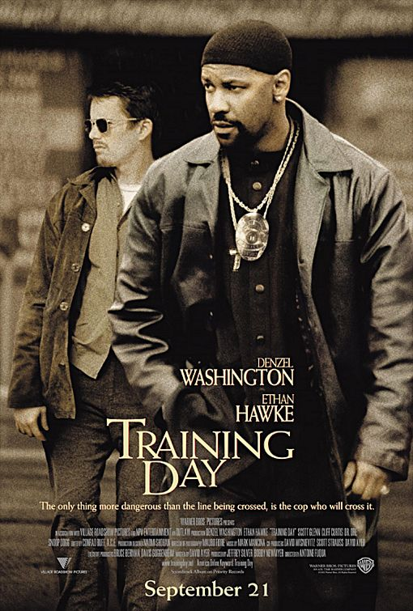
The “Thug”
The “Clown”
Again and again these are the TWO major representations of African Americans in mainstream media

Slide 14
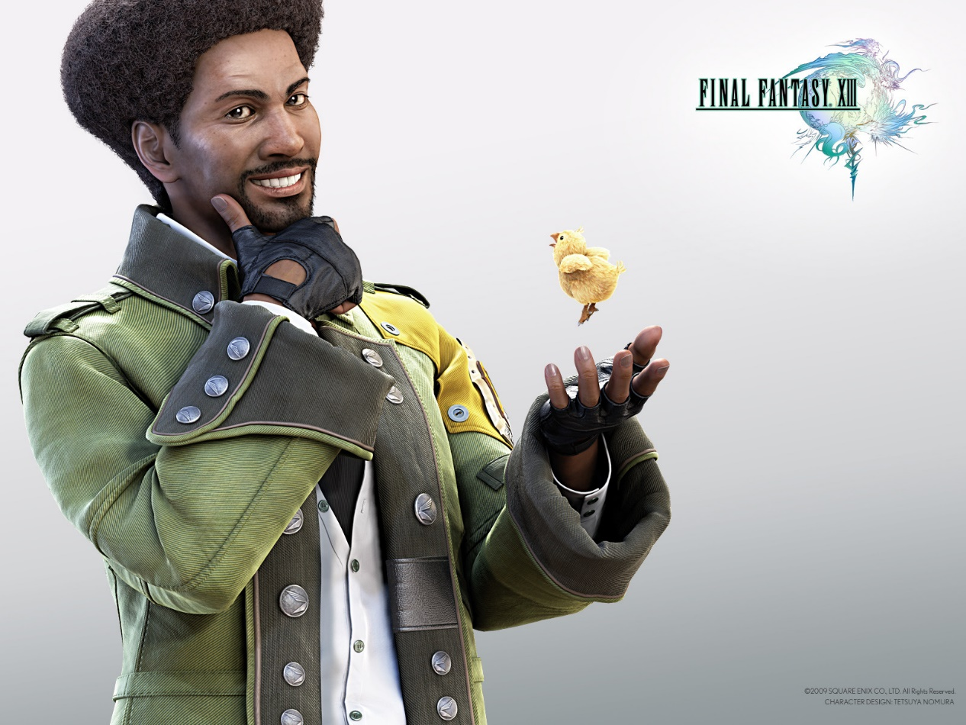
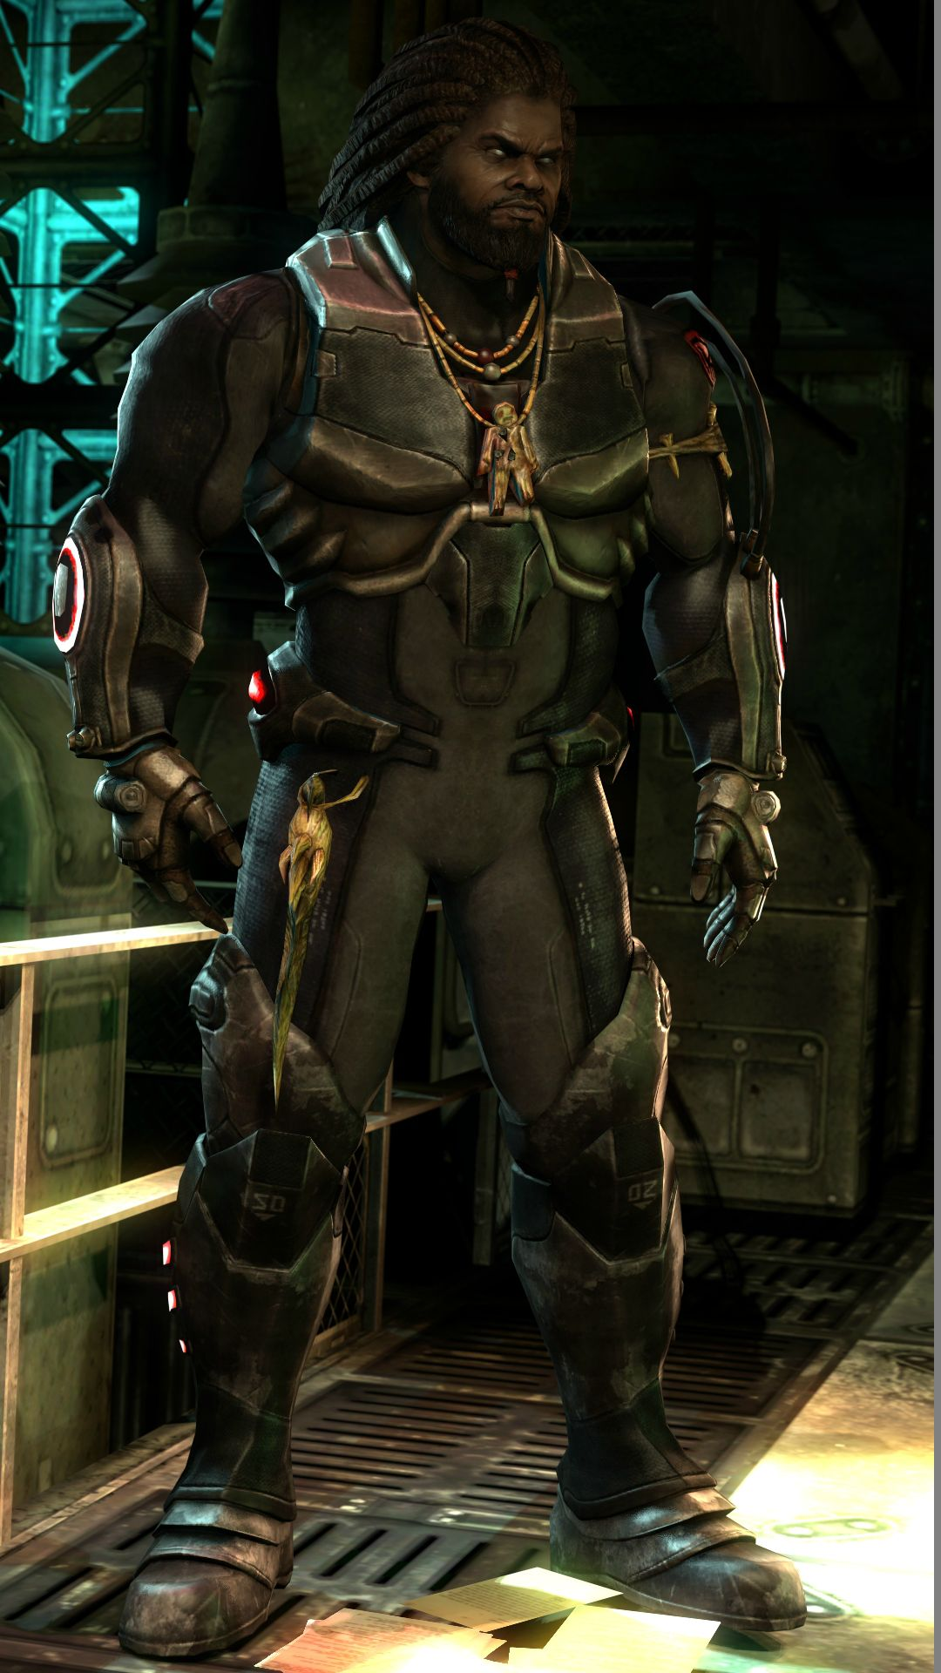
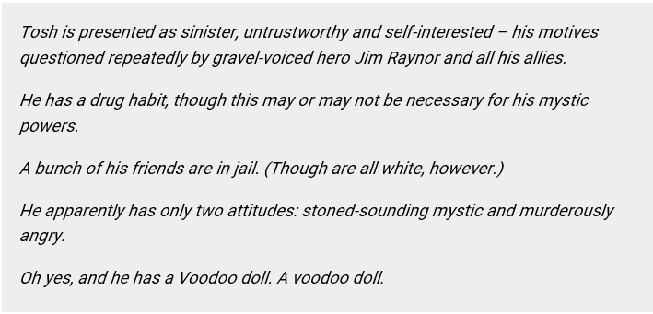

Slide 15
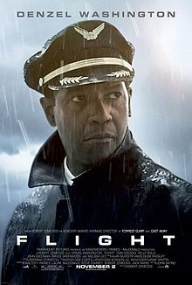
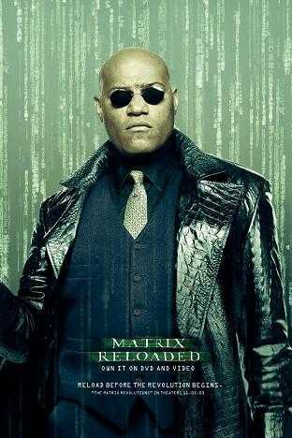
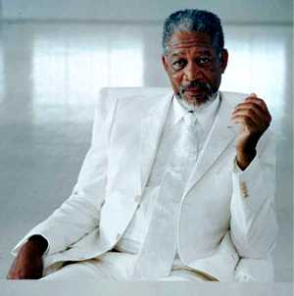
Are things better?
Sure, many African American actors and actresses exist, but again, how are they represented?
What roles are available to them?
The real change needs to come from Hollywood itself: scripts featuring a DIVERSE range of characters.

Slide 16
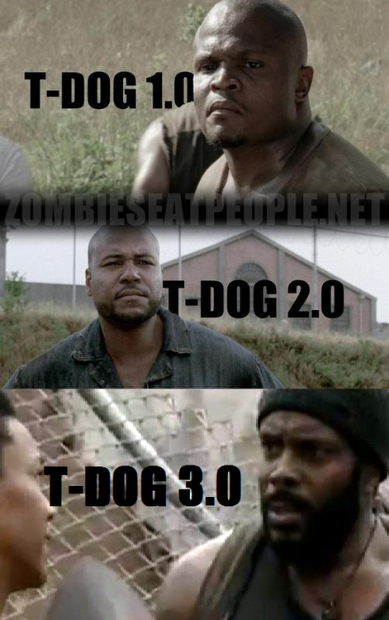
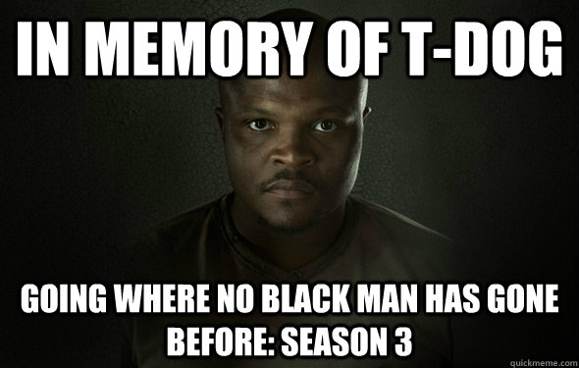
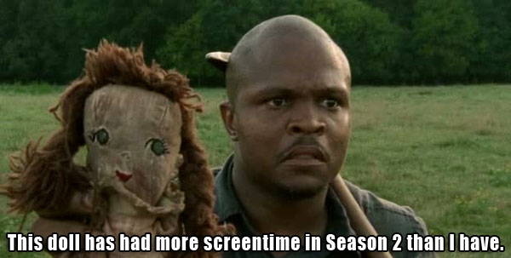
Regarding Television

Slide 17
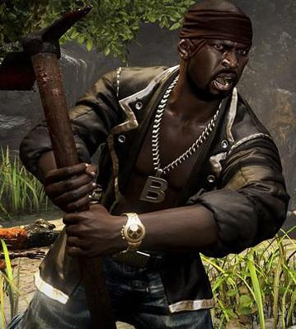
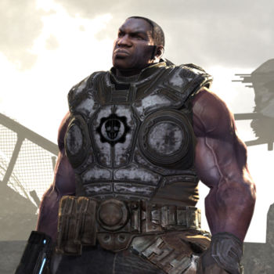
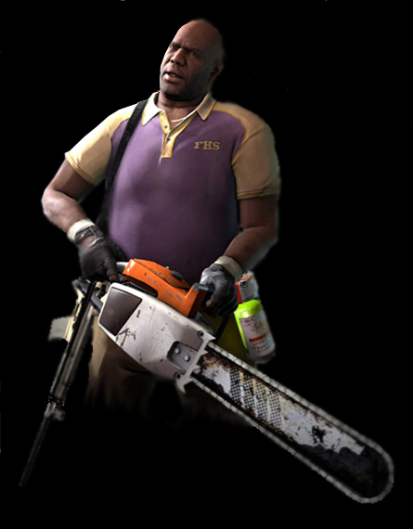
African Americans in Video Games
Sam B in Dead Island
Augustus ‘Cole Train’ Cole in Gears Of War
Coach in L4D2
Often hyper-masculine—interchangeable
Yes, many other games feature hyper-masculine characters, but not all races have a RICH HISTORY of this stereotype as their dominant portrayal.

Slide 18
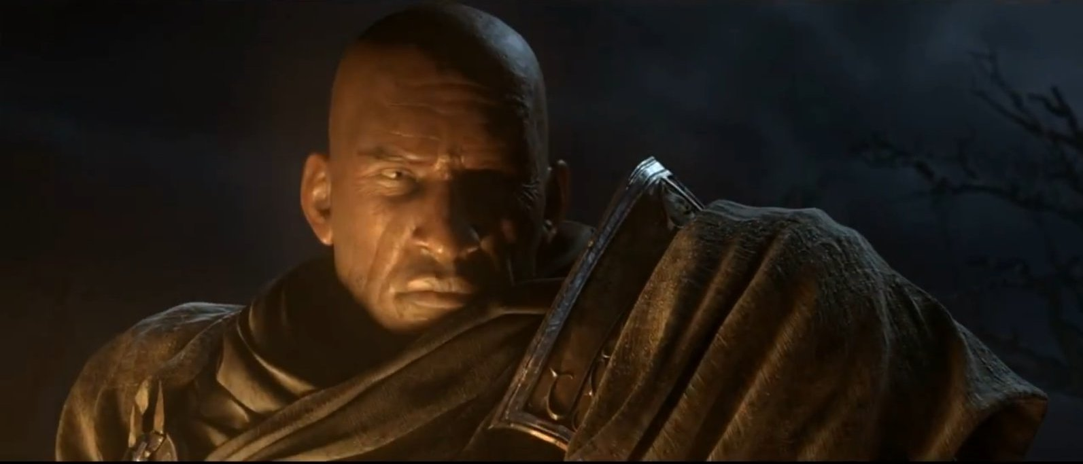
Tyrael from Diablo 3

Slide 19
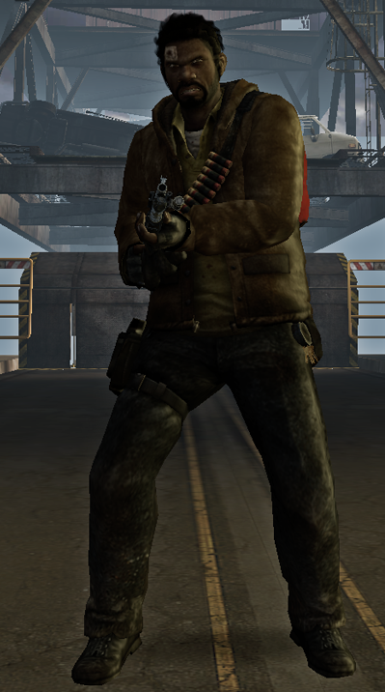
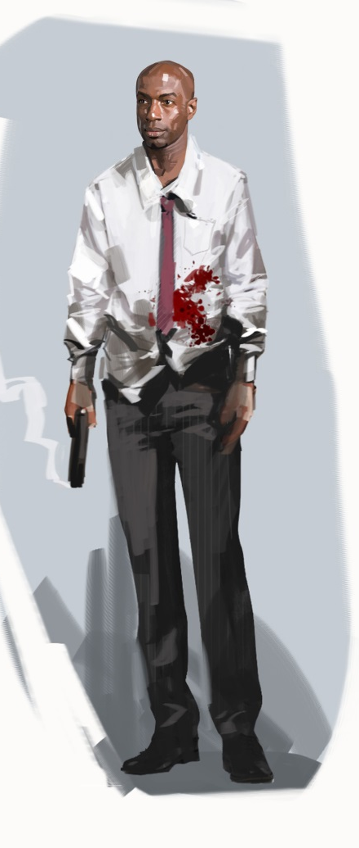
Fun Fact
In the original Left 4 Dead, Louis was originally designed as a more “urban,” thuggish character (though still not as visually stereotyped as most African Americans are).
Valve later re-designed him as an office worker with a very (somewhat, yes, annoying) positive outlook.

Slide 20
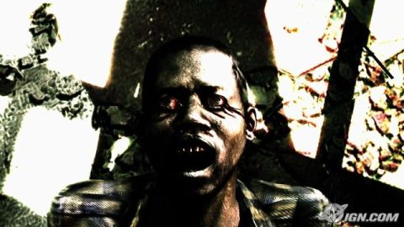
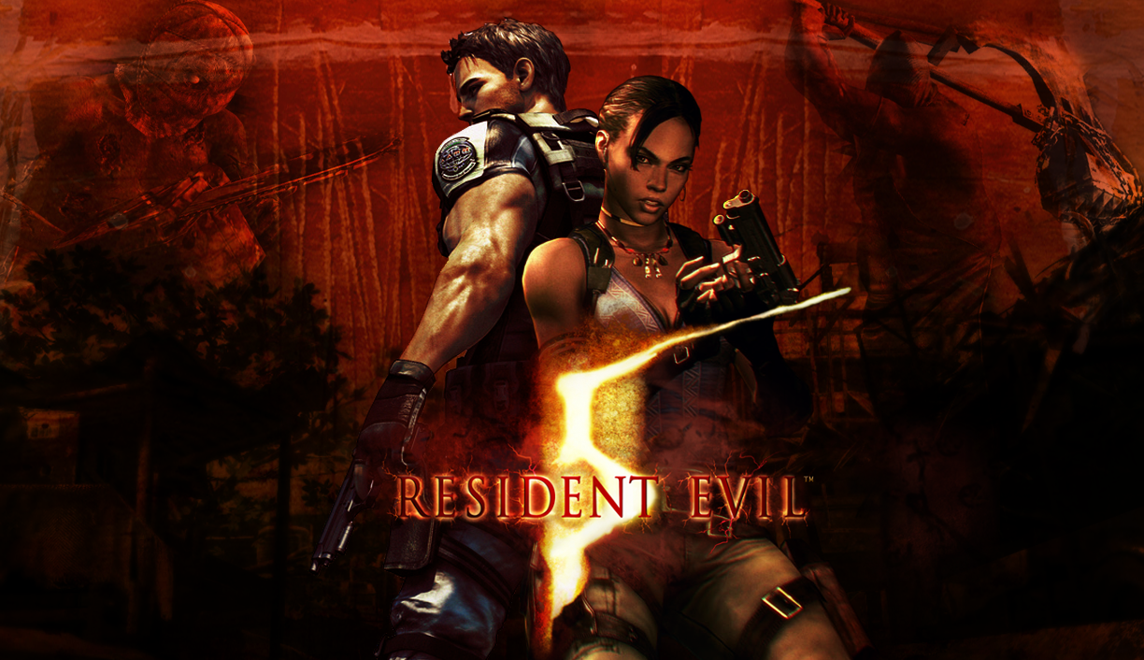
Resident Evil 5
During E3, 2007, the trailer was attacked for its depiction of a white protagonist killing black enemies
Critic N’Gai Croal was particularly upset: “There was a lot of imagery in that trailer that dovetailed with classic racist imagery."
Resident Evil 5 - E3 2007 Trailer [720p HD] - YouTube

Slide 21
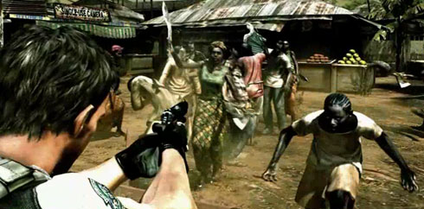
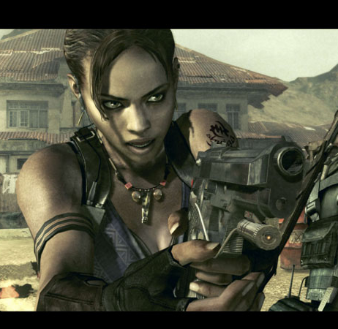
Subtle Historical Racist Iconography
White person (a cop, no less) systematically killing black people.
Fear of Black Savages stealing white women.
And yet, it is in Africa and you do have a non-stereotypical black woman helping you.
Racist? Probably not. Racially insensitive? Yeah.

Slide 22
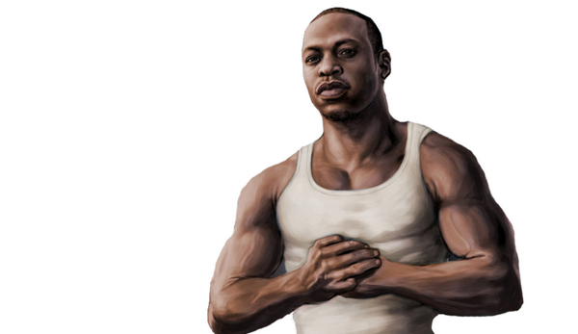
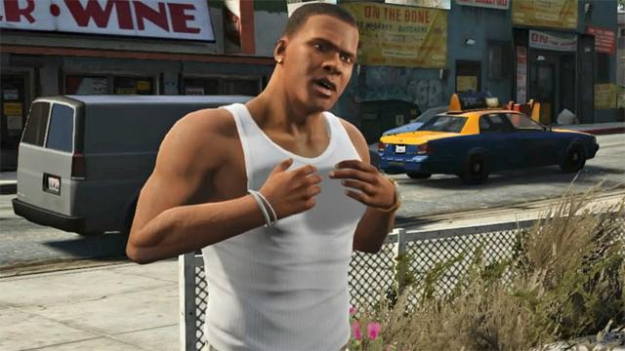
Positive Images of African Americans in VGs
“CJ” Johnson – GTA San Andreas and Franklin in GTA V
Yes, they were (sigh) both linked with gang culture (another stereotype) and again hyper-masculine, but gamers had the choice to change them as they saw fit.
They are also rare examples of black protagonists
Um, why are they dressed the same….?

Slide 23
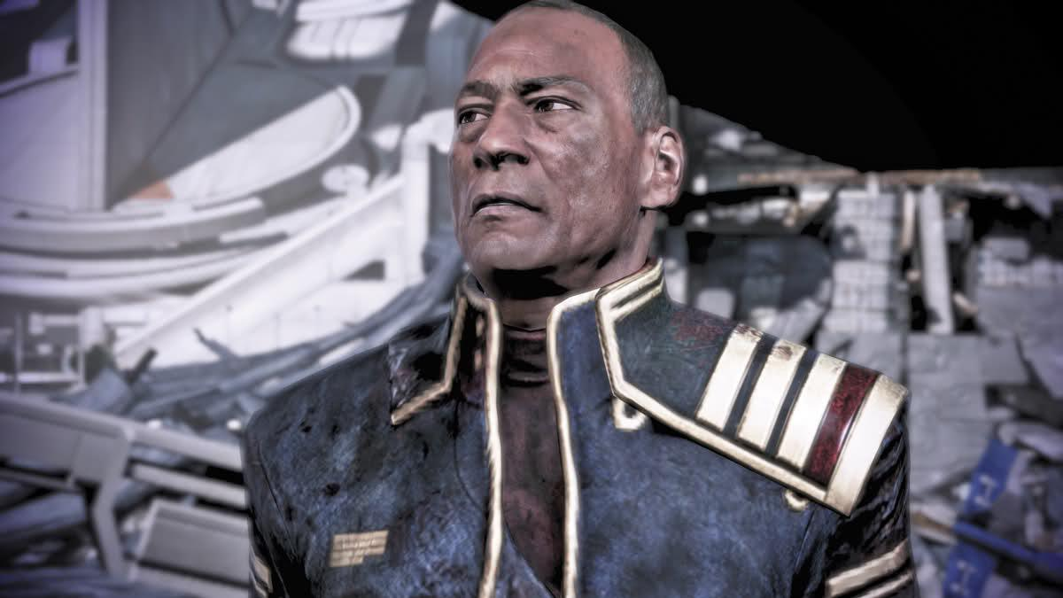
Positive Images
Admiral David Anderson – Mass Effect
He’s an admiral, rather than a grunt like Cole.
You can choose to have him on the Council.
Maintained a central role throughout the series

Slide 24
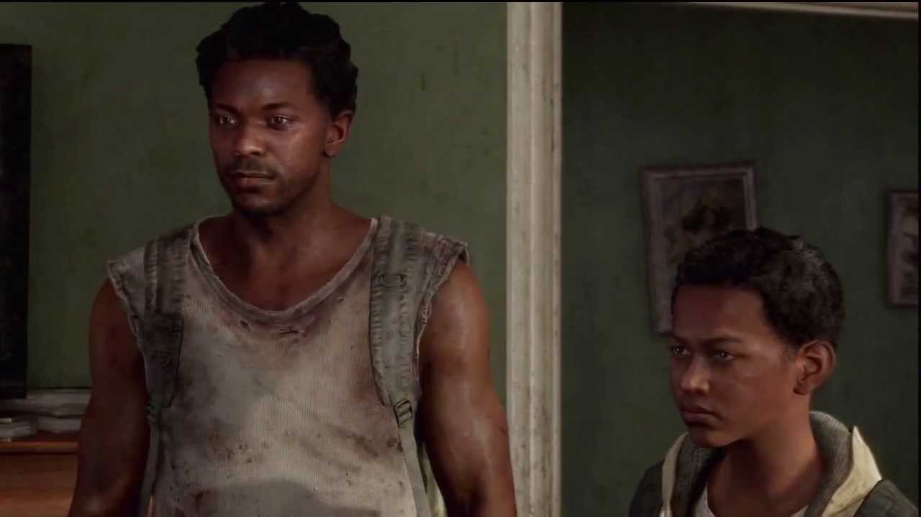
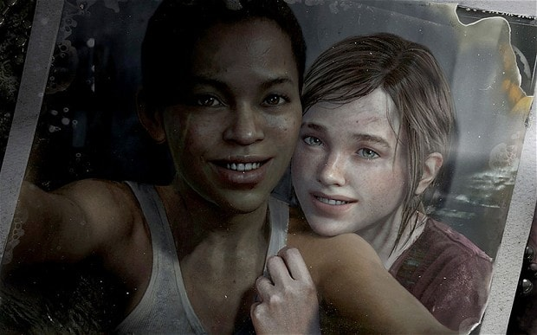
Henry and Sam—brothers— from The Last of Us
The Last of Us DLC—Left Behind—told the tale of Ellie and her friend Riley

Slide 25
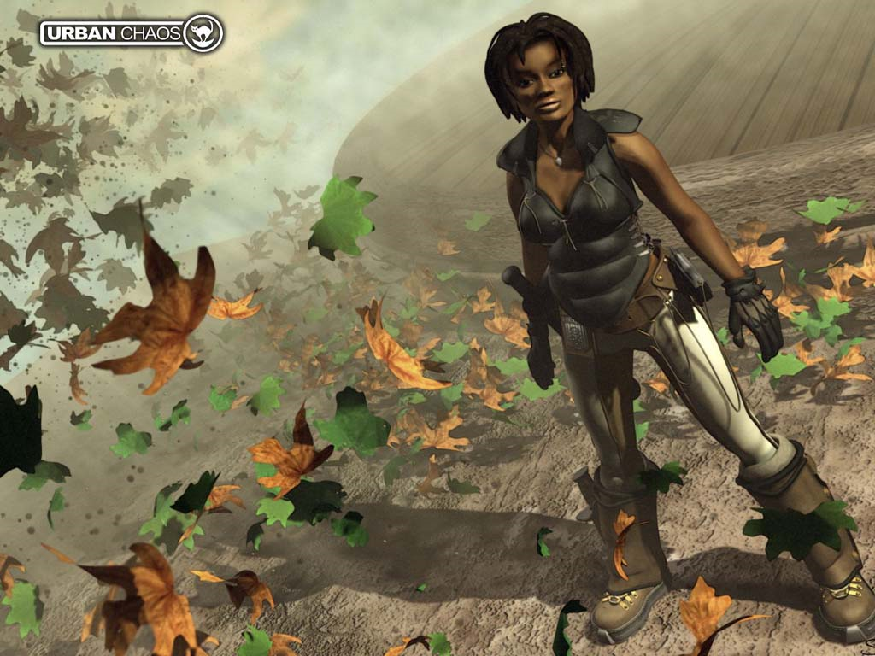
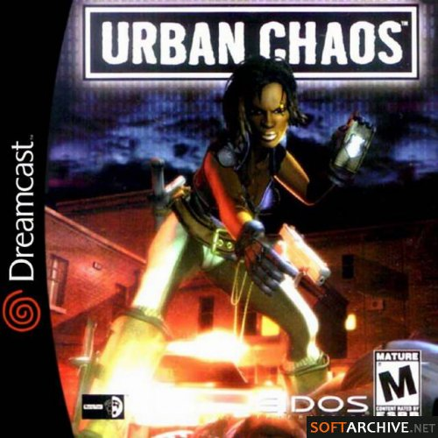
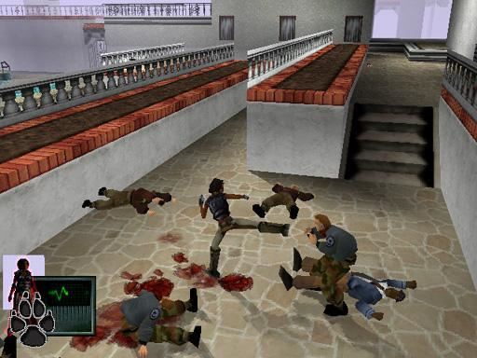
Could Lara Croft have been black?
Before Tomb Raider, Eidos published Urban Chaos (1999) featuring D'arci Stern: a police officer.
Blaxploitation, yes, (sexy, large chest, etc etc) but still—at least she’s a positive role model.

Slide 26
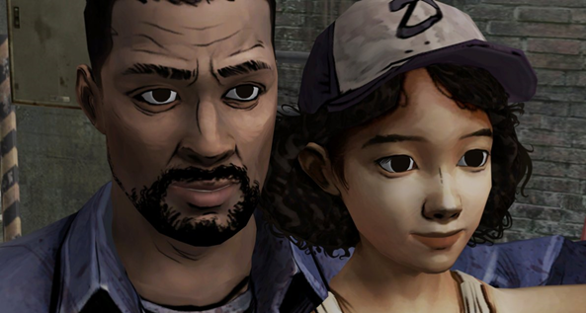
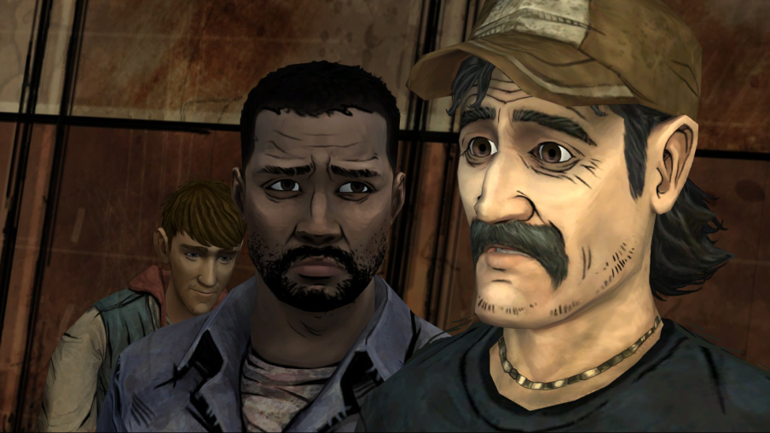
Positive Images
Lee Everett in Tell Tale’s The Walking Dead
One of the most diverse and dynamic video game protagonists—EVER.
Intelligent, caring—a history professor (yes, who apparently murdered someone, but still…).
Jokes with Kenny at one point about not knowing how to use a gun despite being “urban.”

Slide 27
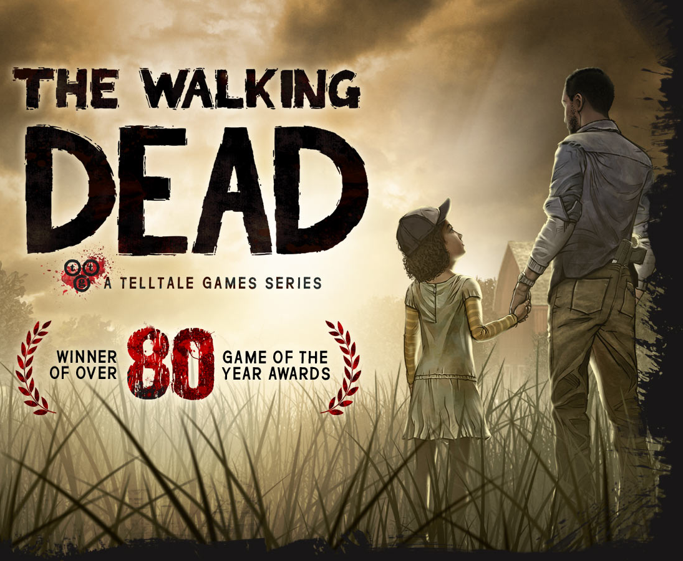
In fact, while we’re on the subject…
Telltale’s The Walking Dead was exceptional not only for an amazing story, but for its inclusion of MANY complex roles for women and racial minorities: proof that an amazing game need not rely on the old “buff white guy with a gun fighting aliens” formula to be successful.

Slide 28
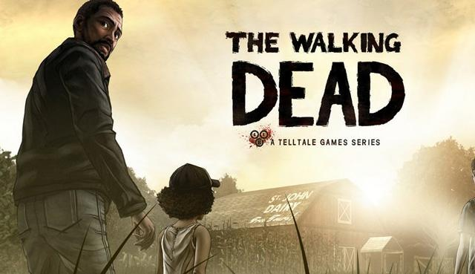



Christa and Omid

Slide 29



Asians in Media
Primarily shown as weak (unless they’re martial artists) with “mystical” knowledge (ie: sage figures), or sexless.
Suffer from the same issue as blacks: portrayed as comic relief or tough guys—no middle ground for emotional complexity.
#STARRINGJOHNCHO

Slide 30


US WW2 Propaganda Poster

Slide 31






Complex Asian Characters in Games?
Faith in Mirror’s Edge
Chell in Portal
Ada Wong in Resident Evil
Ryo Hazuki in Shenmue
Wei Shen in Sleeping Dogs

Slide 32


Jade in Beyond Good and Evil: called both black and Asian, and yet apparently has “no established ethnicity.”
Alyx Vance in Half-Life 2: described as half-black, half-Asian.

Slide 33


Arabs in the Media
There are 338.4 million Arabs in the world.
In the world of both Hollywood and video games there is often only one Arab: the terrorist.
In video games, representation often depends on the genre.

Slide 34




Arabs/Middle East in Games
Delta Force: 1998 game infamous for making all the enemies Arab.
Faridah Malik from Dues Ex: Human Revolution
Actually Persian is NOT Arab, so forgive me for this, but still—geographically it’s in the same area. BTW doesn’t the guy on the box look white?
Yusuf Amir in GTA

Slide 35

Altaïr Ibn-La'Ahad from Assassin’s Creed
Arguably the first Arab character with depth in a video game. Yes, he’s an assassin, but at least a respectable one!

Slide 36




South Asians in Media
Refers to India, Pakistan, Bangladesh.
Often portrayed as shop owners or with exaggerated accents.

Slide 37


South Asians in Games?
Hard to find!
Most visible example is Dhalsim from the Street Fighter Franchise
Stereotypes include a love of curry, yoga, and eastern mysticism.

Slide 38




Natives in the Media
Little to no visibility in mainstream media.
Hollywood often uses the “noble savage” narrative where the white hero saves the tribe.
Other cliches are feathers, tomahawks and a connection to the spiritual.
And then there’s “white washing”…

Slide 39

“White washing”
Hollywood practice of using a “white” star in place of non-white character.

Slide 40


X-men Origins: Wolverine: Silver Fox is described as a Native Canadian Black Foot. The character is played by Caucasian actress Lynn Collins

Slide 41


Custer’s Revenge
Controversial game that was produced for the Atari 2600
“In the game, the player controls the character of Custer, depicted as a man wearing nothing but a Calvary hat, boots and a bandana, sporting a visible erection.” – Wikipedia
Custer has to overcome arrow attacks to reach the other side of the screen.
His goal is to have sex with a naked Native American woman tied to a pole.

Slide 42


Natives in Games
Thunder Hawk from Street Fighter.
Night Wolf from Mortal Kombat
Humba Wumba from Banjo-Kazooie
And Turok from Turok of course.

Slide 43


Prey (2006)
Domasi "Tommy" Tawodi, the main character, is “a step away from typical Indian stereotypes by offering a complex character who is not the typical Indian of popular culture.”
Both praised and criticized for its depiction of Cherokee culture. Still, a step (mostly) in the right direction.

Slide 44



Connor Kenway in AS III
infamous: Second Son features the Native protagonist Delsin Rowe (a graffiti artist and the local delinquent of the Akomish reservation) but is voiced by Troy Baker

Slide 45

Players control the Iñupiaq (Native people of Alaska) girl Nuna and her Arctic fox in this “atmospheric puzzle platformer.”

Slide 46

Far Cry 3 Controversy
Criticized for its use of the noble savage/White Knight cliché
You are the white man who has come in and saved the natives—and become their leader! Go white boy, go!
An allegory for Colonialism

Slide 47


Other points: “sexualization of the exotic Native Queen,” the reliance on the “noble savage” cliché in the narrative, as well as character dialogue: white enemies complain about the heat; native enemies complain about the heat, their STDs, and how they need another “hit” of drugs.

Slide 48
Response from FC3 Writer!
“Yes! It’s NOT! It’s the opposite! The game is the opposite. It’s so funny to me. I’ve seen these arguments on forums, and I think these arguments are fantastic because people are engaging in a discussion about art, which is exactly what I was hoping would happen. But, the game’s argument is that Jason is basically used by everyone on the island – Jason is basically a gun, that is upgraded by the natives on the island. It’s the opposite of Avatar.” - Jeffrey Yohalem (lead writer)
Far Cry 3 Isn't Racist. You Just Didn't Get It.

Slide 49


Latinos in the Media
Often in exaggerated stereotypical roles (mob, sexual seducers).
Yes famous Latinos exist—but HOW are they represented?
Are they leads?
J-Lo as a maid doesn’t count.

Slide 50







Latinos in Games
Dominic “Dom” Santiago in Gears of War
Rico Velasquez from Killzone
Sergeant Cortez from TimeSplitters
Rico Rodriguez from Just Cause
Carlito and Isabella Keyes in Dead Rising
James Vega from Mass Effect

Slide 51




Dying Light (2015)
Takes place in the fictional city of Harran in Turkey. Features a wide array of races and ethnicities (mostly) displayed with dignity and diversity.
While I’d never claim DL is ground-breaking in its use of race, it at least isn’t offensive (and that’s saying something where VG’s are concerned.)

Slide 52
In the end: why should you care about racial representation in gaming?
Representing races, genders, and sexual orientations with variety and dignity is important for obvious reasons: no one wants to be reduced to a cliché or dehumanized (for a cheap laugh).
Art that embraces a wider range of representation is more emotionally rewarding and enriches our culture.
Ignorance is no excuse; respect your audience.

